Slide 1
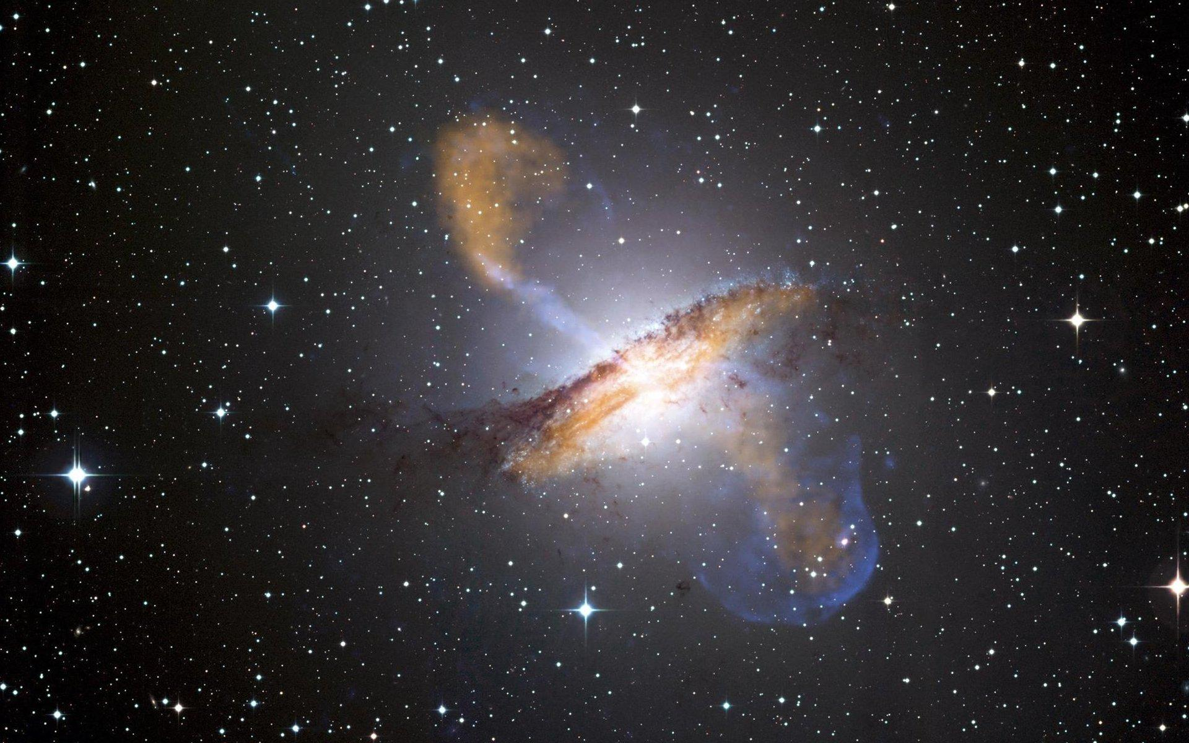
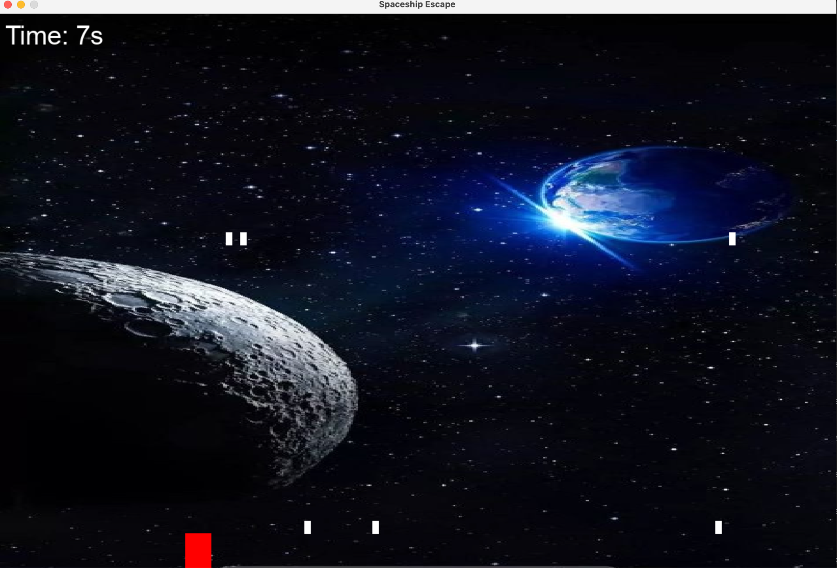
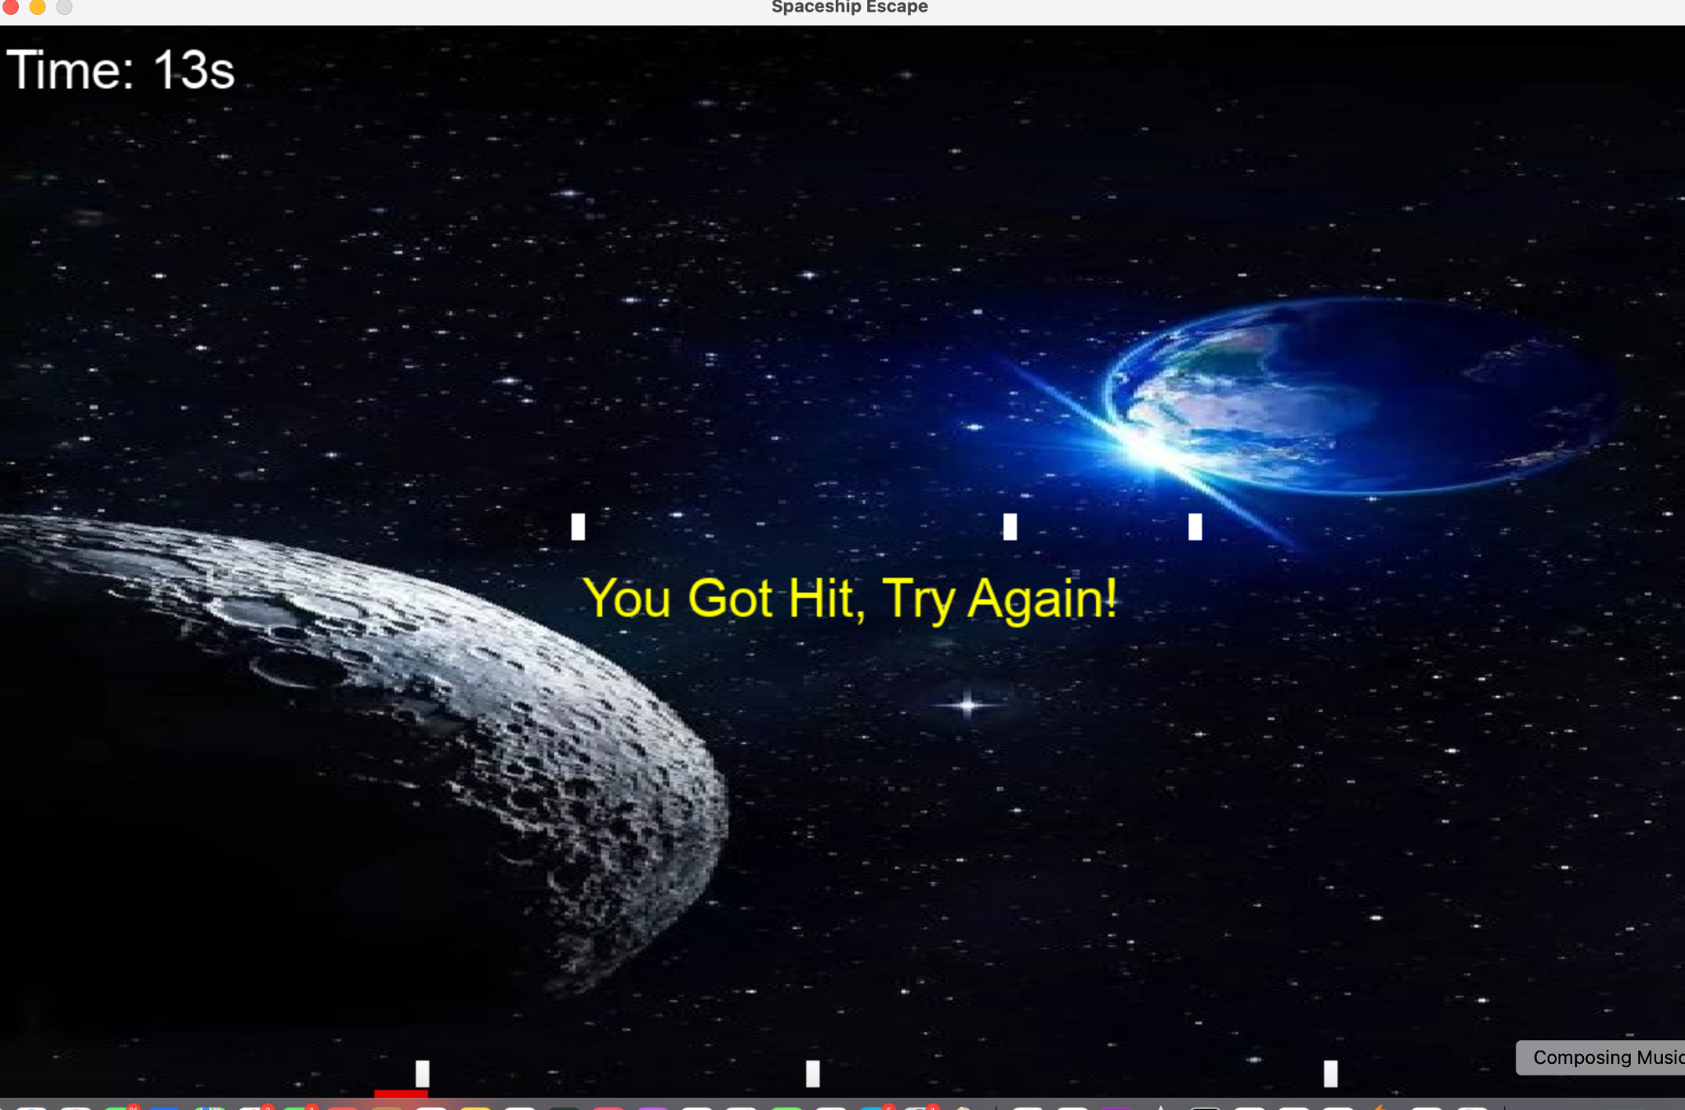
Spaceship Escape
Amaya Ballard
Arielle Brown
Escape space by avoiding the falling asteroids and making it back to earth.

